Slide 1


Group 2

Slide 2
“Use artificial intelligence to solve the bottleneck of insufficient support for small and micro enterprises”

Slide 3
CONTENT
01
Group profile
02
Company background
03
Company analysis
04
Technology strategy

Slide 4
01
Group profile
03
Wang Ruotong &
Tan Haoyuan
Analyze bottlenecks and develop a FinTech strategy.
Long Yuanfang & Li Guoyi & Tang Diyun
Analysis of Porter’s Five Forces and traditional banking competition.
02
04
Chen Liwen
Assign work, produce presentations, analyze SWOT, participate in pre.
Sun Qiyue
Search for background information and key services of Bank of China.
01
05
Zhu Lei
Identify topics, provide information and literature,and participate in pre.

Slide 5
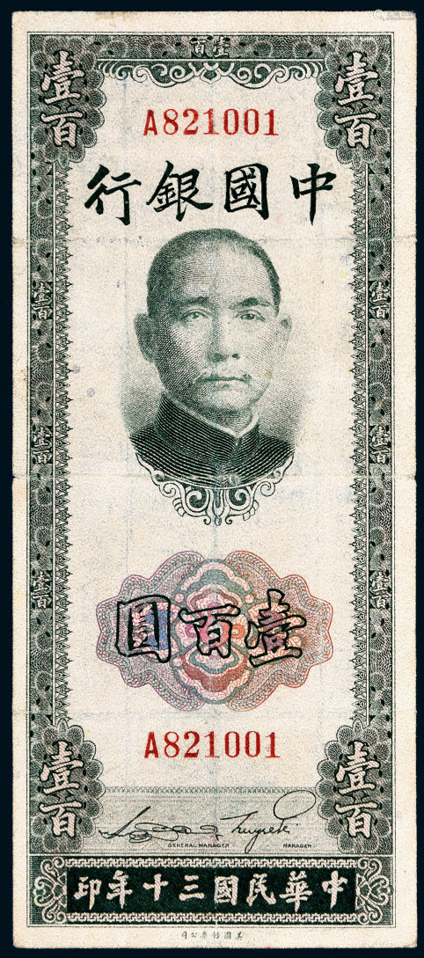
02
Company background
1905
1908/02
1912/02/05
Hubu Bank
the earliest national bank in China
Daqing Bank
It was renamed.(also known as "Beijing Normal Headquarters")
Bank Of China
Under the instructions of Dr. Sun Yat-sen, it was renamed and established in Shanghai.

Slide 6
02
Company background
B
A
Commercial banking
It is the traditional main business of BOC, including corporate finance, personal finance and financial market Business.
Corporate banking
Including Deposit business, loan business, financial institution business, international settlement and trade financing business.
B
A
D
Main business
C
Personal banking
Savings deposit service, personal intermediary service, private banking service, bank card service
Channel construction.
Financial markets business
BOC operates its capital business primarily through five trading centers in Beijing, Shanghai, Hong Kong, London and New York.
D
C
Bank loan financing business tends to higher end customers, such as large enterprises. Personal business is positioned as the middle end, but it is more inclined to serve medium and high-end customers.

Slide 7
03
Company analysis
Porter's Five Forces Analysis

Slide 8
1. BARGAINING POWER OF SUPPLIERS
01
Structure of suppliers
All kinds of deposits are the main body of the bank's liability business and the main input of the bank, and the credit products and services sold by the bank are heavily dependent on various types of deposits. The structure of this input severely weakens the bargaining power of banks and relatively increases the bargaining power of the supplier.
03
Ability to substitute
The asset structure of banks has undergone great changes, and the proportion of deposits has gradually decreased; the proportion of medium- and long-term bonds and short-term borrowings has become higher and higher. There will be more and more alternatives to supply-side credit funds, invisibly weakening bargaining power.
02
Size of suppliers
With the improvement of the income level of Chinese residents, there are more and more channels for suppliers to obtain information, the demand for financial products is becoming more and more diversified, and the number of suppliers available.

Slide 9
Number of customers
The buyer of wholesale business is generally a large industrial and commercial enterprise, government institutions, and the amount of banking products purchased by them is generally larger and more concentrated, so its bargaining power is relatively strong.
2. BARGAINING POWER OF BUYERS
Switching costs
Buyers can buy products from any commercial bank with low switching fees. This determines that buyers can drive down the prices of goods sold by banks.
Buyer’s information availability
With the development of science and technology, buyers understand the performance of bank products, the structure of bank products, and the cost composition of bank products, which invisibly improves the bargaining power of buyers.

Slide 10
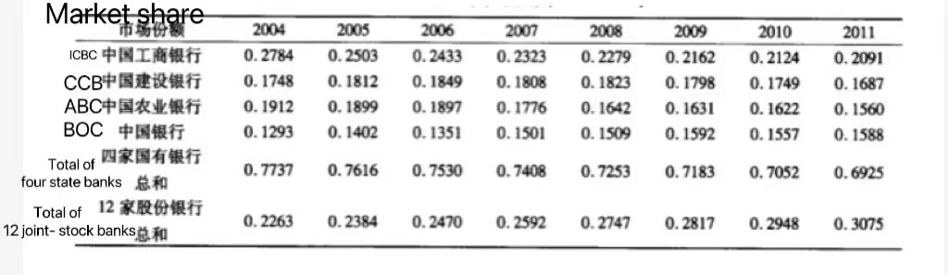
3. THREAT OF NEW ENTERANTS
Barriers to entry
The absolute cost advantage barrier of the banking industry, that is, in addition to the cost advantage of the production process compared to the new bank, there are special scarce resources.
Brand loyalty
It can be seen that each of the four state-owned banks in China occupies a large market share.The current market structure of China's banking industry is in an oligopoly state.
Government policies
New Chinese banks have a minimum registered capital that is much higher than that in developed countries.
Economies of scale
With the development of China's market economy and the WTO rules, China has a large industrial attraction.

Slide 11
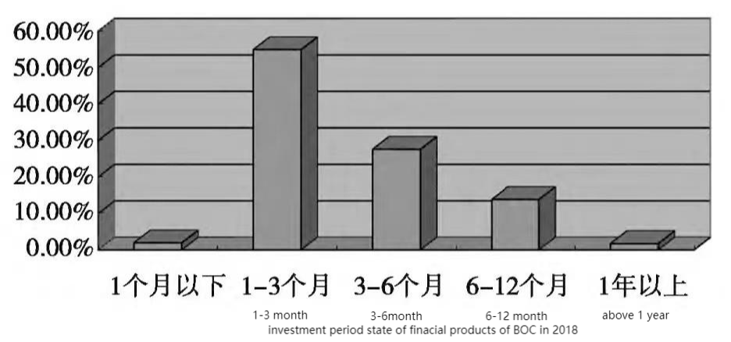
4. THREAT OF SUBSTITUTE PRODUCTS
Fund trading market:
Most of the bank financial products are invested in bond assets, which is less risky. The investment direction of different types of funds is quite different.
For example, bond funds mainly invest in fixed expected income securities, which have relatively low risk, while stock funds mostly invest in equity markets, with relatively higher risks.
The expected return rate of money funds and bank financial products is on a downward trend.However, in the short term, the expected yield rate of bank financial products is slightly higher than the expected return of funds.
The financial products of BOC are mostly concentrated in the range of 1 to 3 months and 3 to 6 months, and the period is relatively short.

Slide 12
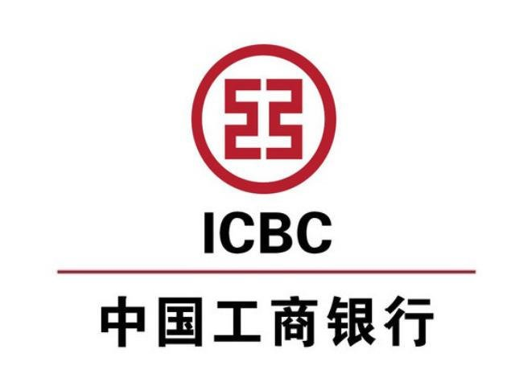


5. RIVALRY AMONG DIFFERENT COMPETITORS
The main competition is four state-owned commercial banks (Industrial and Commercial Bank of China, Agricultural Bank of China, China Construction Bank and Bank of Communications).
And 12 joint-stock banks such as China CITIC Bank, regional joint-stock banks such as Bank of Chengdu. There is also secondary competition from multinational banks.
Bank of China has long ranked third to fourth in the rankings over the years, and Industrial and Commercial Bank of China and China Construction Bank have long been in a leading position.

Slide 13
International advantages
High degree of internationalization
Beijing Olympic Games Partner
S
W
Poor attitude and high fees
Excellent domestic economic environment
The field of personal consumer credit is prominent
Release of potential financial demand in urban and rural areas
O
T
Technologically advanced banks

Slide 14
04
Technology strategy
Banks mainly consider that the capital risk of small and micro enterprises is large, and this bottleneck can be well solved through artificial intelligence.
Change the original loan methods and loan concepts.
Innovate
Combined with financial technology, establish a loan method for small and micro enterprises and personal loans.
Use big data to collect user information and strengthen the management of credit reporting.
Manage
How to support small and micro enterprises
Comprehensively assess the credit status of users and formulate a variety of loan products.
Simplify the loan process.
Simplify
Enhance the attractiveness of financial products to users

Slide 15
04
Technology strategy
Multi-party security diagram computing technology
Optimize the approval risk control process
Use big data to replace offline investigation work with data calculation and analysis.
Supported by a risk control platform
Integrate internal bank data sources with external data sources such as governments.
Break down existing data silos
Ensure that the raw data does not leave the domain
Artificial intelligence such as multi-party security diagram calculation are supplemented by paper materials and on-site visit audits, which improve the timeliness, convenience and security of bank inclusive finance.

Slide 16
04
Technology strategy
Timeline
Cost
01
Build a platform and hire professionals.
6m
Improve the construction
Start to solve the problems encountered in the previous stage and reform and innovate
02
Improve platform construction and supplementation.
Contingency Plan
Set up a backup contingency plan to anticipate in advance what impact this approach will have on the entire banking system and public services
3m
Customer mining
Set up a mechanism to attract customers and ensure the operation effect of the system.
03
Trial operation and simultaneous customer mining.
。
6m
Manpower
Hire and develop engineers and other talents.
04
Improve and supplement the previous problems and reform and innovate.
3yrs
Platform construction
Develop professional platforms and integrate technologies such as digital intelligence into banking business such as risk control.

Slide 17
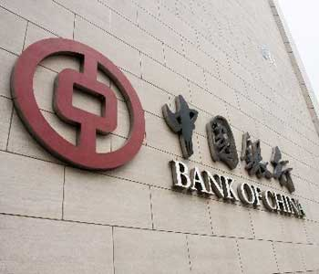
bibliography
1
Research on the Competitive Strategy of Bank of China, Yang Yi
2
Investment period state of financial products of BOC in 2018
3
Analysis of Five Forces of Banking International Competition, Shao Xinli, Xu Yuanyuan
4
Zhang Runhong, Problems and countermeasures of China's financial products in bancassurance, https://wh.cnki.net/m/article/detail/XZKX201606018
5
Zheng Xin, Research on Marketing Strategy of Commercial Banks in China--Take BOC for example, https://wh.cnki.net/article/detail/HLJW201708034
6
Jia Liu. Research on Financial Product Promotion Strategy of Commercial Banks. Finance and Economics (Academic edition), 2015 .
7
Zhang Lilin. We will promote the reform of the banking financial management divisional system. China Finance, 2015 .

Slide 18
感谢聆听
Thank you for your listening

